Slide 1
Collecting and Storing Data with Arduino
Brandon Wood
Weston 2017

Slide 2
Wiring
In order to use the sensor, we’ll need to wire it!
Remember to plug in the battery pack. I’ll include a link to in case anyone is interested in doing this themselves. We need the battery pack to power the Arduino in the absence of the computer.
In addition to the Arduino, we’ll need a
Breadboard
Jumper cables
HTP-11 sensor
Battery pack

Slide 3
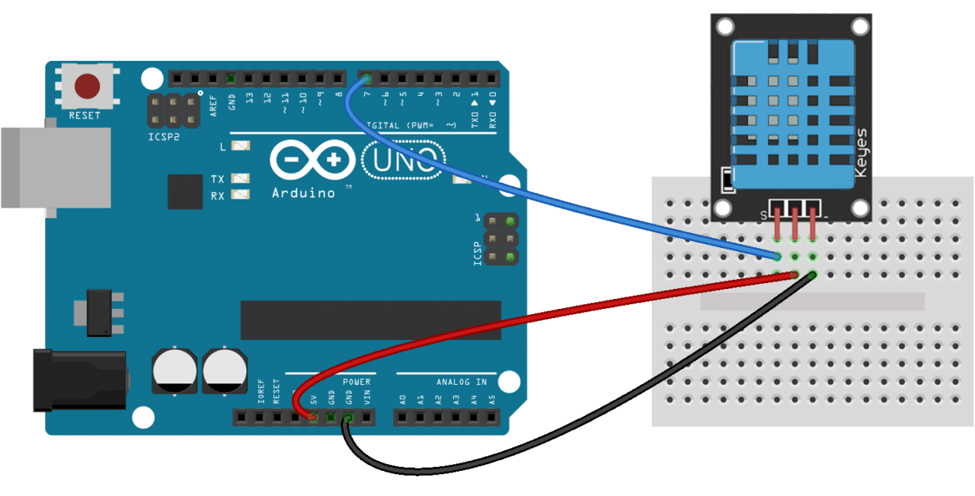
Wiring
You can wire it as so:

Slide 4
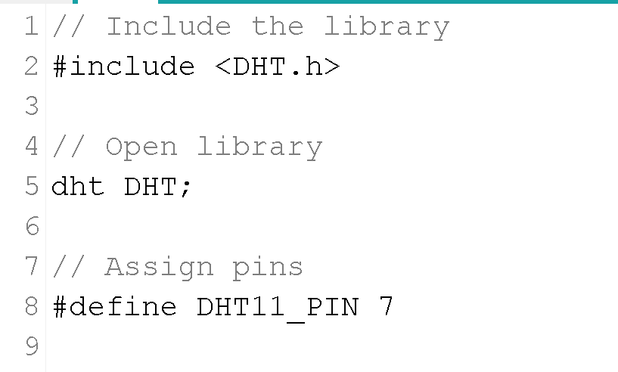
Setting Up
This is where the fun begins. When the sensor sends a signal, it comes in the form of electrical pulses. Reading those pulses is its own art form and we can spend plenty of time talking about just those protocols.
To avoid this, we’ll use a hardware library, provided by the company that makes the sensor. We can do that as follows:

Slide 5
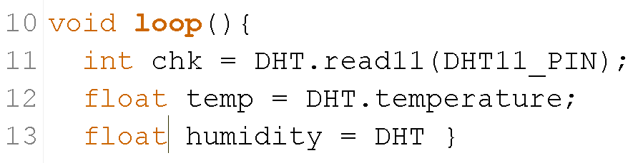
Reading Data
We can read the data by initializing the sensor and using the following methods. Remember, it has to be read inside the loop statement, otherwise the Arduino won’t run it continuously.

Slide 6
Storing Data
Now we’ve accessed the temperature, but if we leave the Arduino as is it will continue to rewrite the same variable over and over, preventing us from storing the data. Similarly, if we unplugged it and tried to access the data it would be lost.
We need to use something called EEPROM memory to store it.
Here’s a nice little overview of EEPROM: http://whatis.techtarget.com/definition/EEPROM-electrically-erasable-programmable-read-only-memory

Slide 7

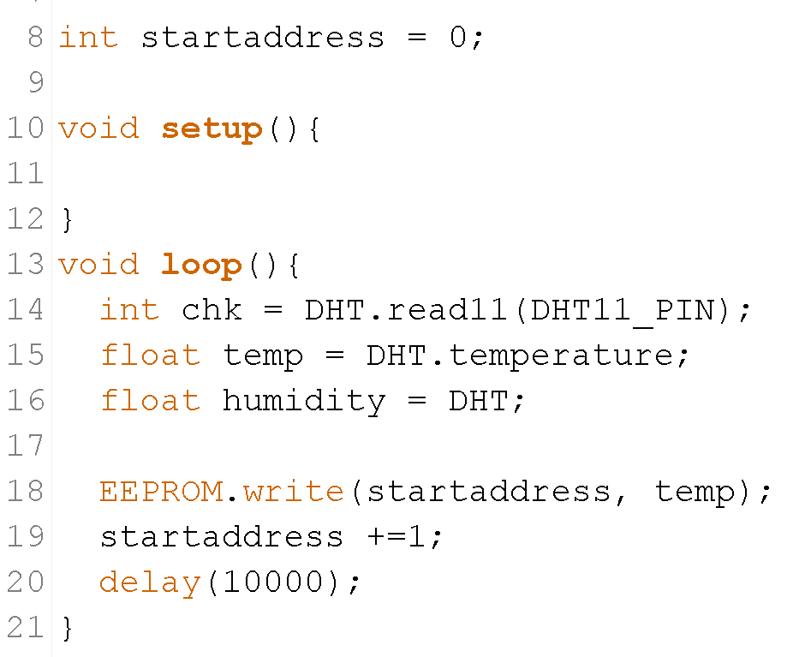
Storing Data
Let’s store our temperature or the humidity in the EEPROM memory.
We can include the library as follows:
Then write data to it using its write() function

Slide 8
How does this work?
Every time we save memory, we need to give it an address. This is similar to a variable name.
This addresses here are numbers, and every time we write the data, we increase the address by one, moving us to the next address.
When we write, we give it the address, then the value.
We wait for 10 seconds after each measurement so the data is not too granular (although it should probably be much more).

Slide 9
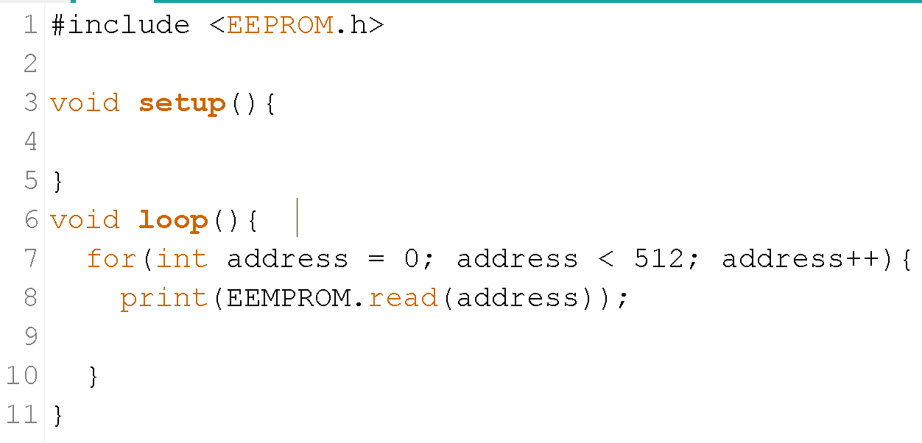
Reading the data
Once we’ve written the data, we’ll need to access it to do cool analysis and whatnot.
When we’re ready to collect it, we can add a new script to the Arduino to print all the data over serial, which we can copy and paster into Excel or something by looping through the addresses (0-511).

